Slide 1
XAML

Slide 2
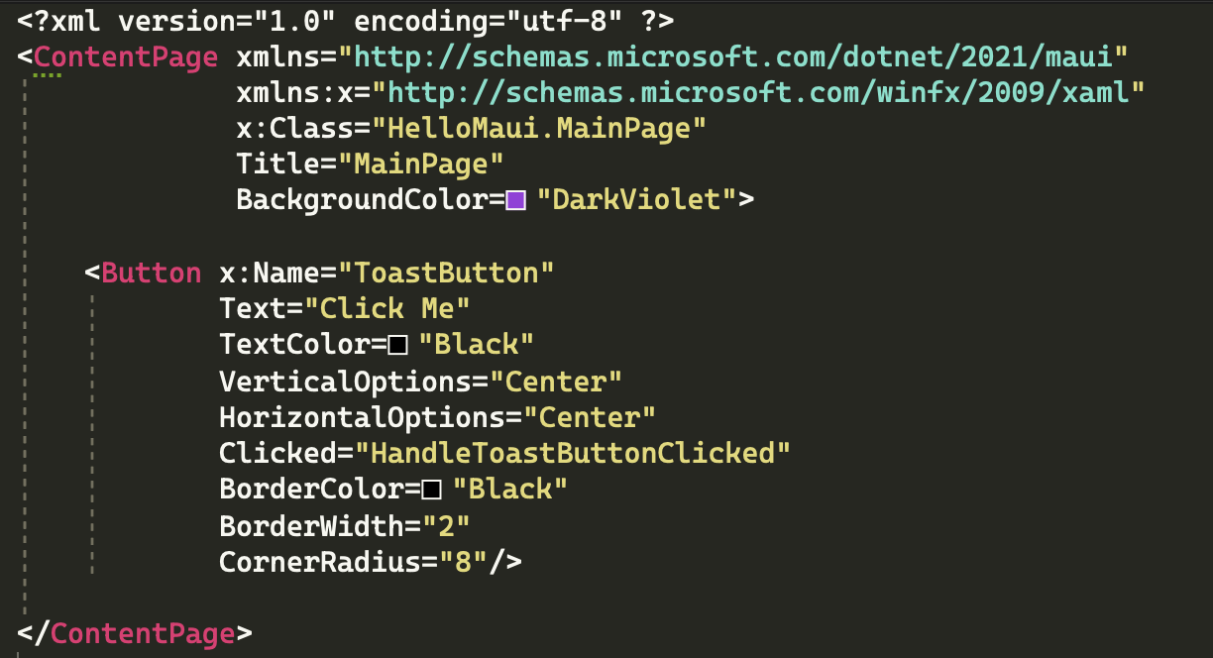
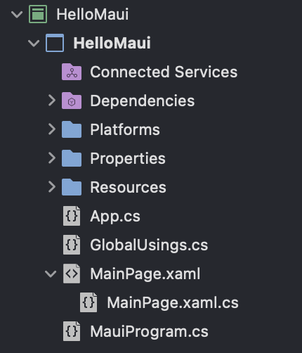
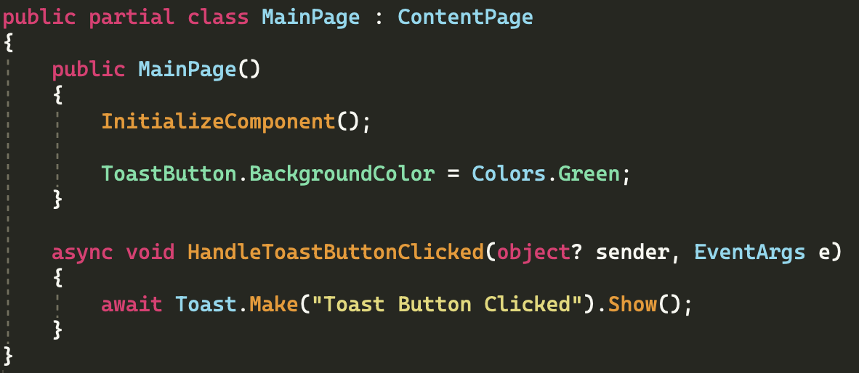
Creating UI XAML (eXtensible Application Markup Language)
An alternative to C# for creating UI
Can not contain logic
E.g. Event Handlers must be written in C# code-behind
Use x:Name to create C# Property in code-behind

Slide 3
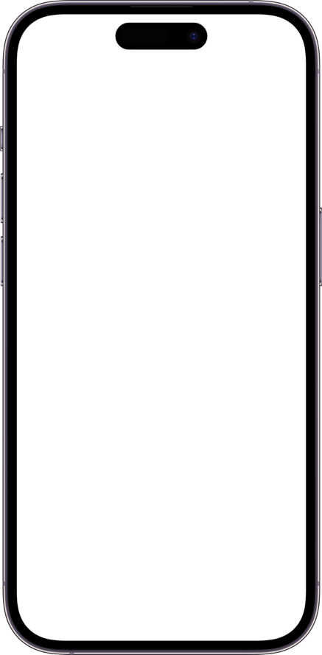
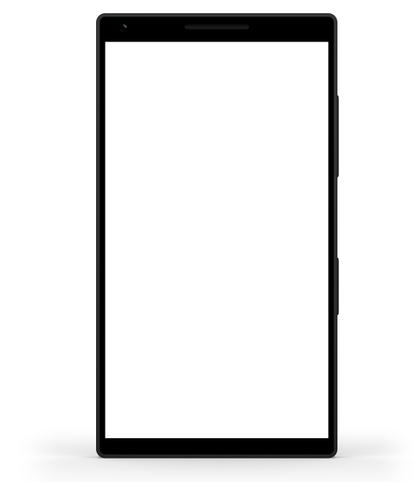
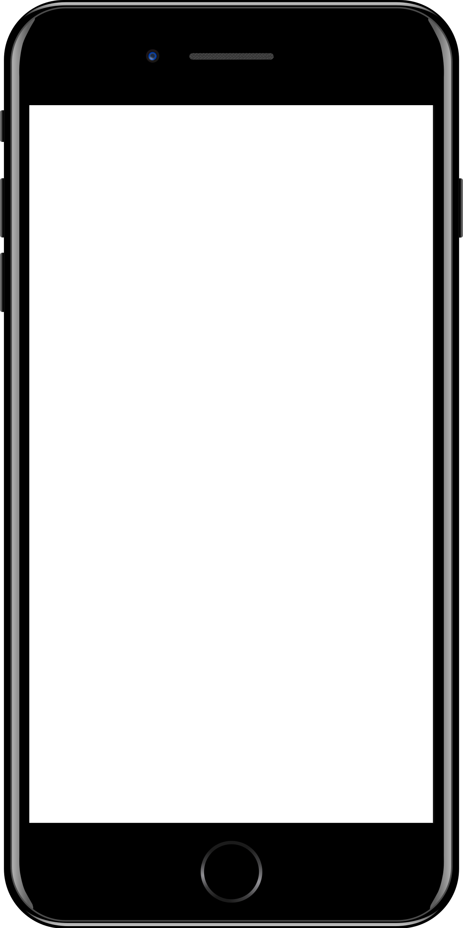
Sample mobile app slide
iPhone 7/8
iPhone 14
Generic phone
(BrandCentral)
App screenshots can be placed behind these transparent .pngs

Slide 4

Sample website slide (blank)
Website screenshots can be placed behind this transparent .png

Slide 5
Bullet points layout with subtitle Subtitle is smaller in the same text block
Example of a bulleted slide with a subhead
Set the slide title to “Sentence case”
Set subheads to “Sentence case”
Hyperlink style
www.microsoft.com

